Slide 1
Predicting Variant Dominance: How Far Can Early COVID-19 Trends Take Us?
Franky Zhang
Ph.D. Student, Department of Statistics, UConn
Oct 08, 2025

Slide 2
Introduction
Current Landscape and Challenges:
The SARS-CoV-2 pandemic created a natural experiment for studying viral evolution and competition [1].
Timely identification of emerging dominant variants remains difficult due to:
Rapid mutation rate and diverse variant pool, with low-prevalence lineages (0.01–3%) sometimes later dominating.
Wide variation in immunity, vaccination, and interventions across countries, complicating global generalization [2].
Existing models mainly focus on nowcasting approaches (e.g., CDC, 2–3 weeks): effective short-term but lack long-term lead time [3].
Many existing predictive models are tailored to specific time periods and particular types of variants, which limits their generalizability [4].
1

Slide 3
Introduction
Our Research Focus on Two Key Questions:
with “Early-stage” Sequences Only,
(1) Which variants emerge to dominance?
(2) How long do they sustain dominance?
Main Contributions of Our Research:
Developed a scalable predictive framework using sequence-only models to analyze early growth trends without heavy biological or epidemiological inputs.
Conducted a systematic comparison of machine learning models, evaluating accuracy, stability, and robustness across countries.
Applied SHAP analysis to enhance interpretability and identify early signals.
Aim for early-stage variant assessment and rapid prioritization, when genomic data exist but epidemiological evidence is still limited—helping guide surveillance focus and public health response.
2

Slide 4
Data Processing
“Better data beats fancier algorithms.”

Slide 5
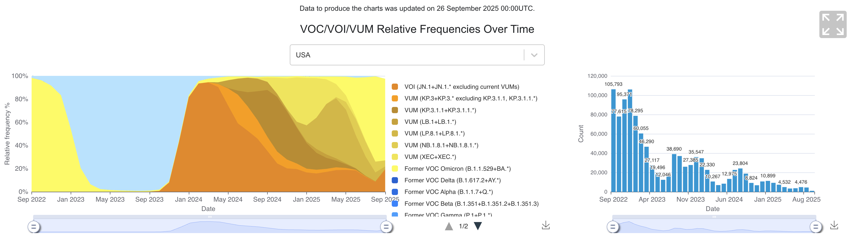
Data Loading
Genomic Data Repository:
All SARS-CoV-2 sequences used in this study were obtained from GISAID (Global Initiative on Sharing All Influenza Data, www.gisaid.org), a global platform for viral genome sharing
Why Use GISAID Data:
Leveraging these large-scale, high-resolution datasets, we examine SARS-CoV-2 lineage dynamics across 15 high-burden countries (2020–2024), enabling early-stage feature extraction and predictive modeling of variant dominance and duration.
3

Slide 6
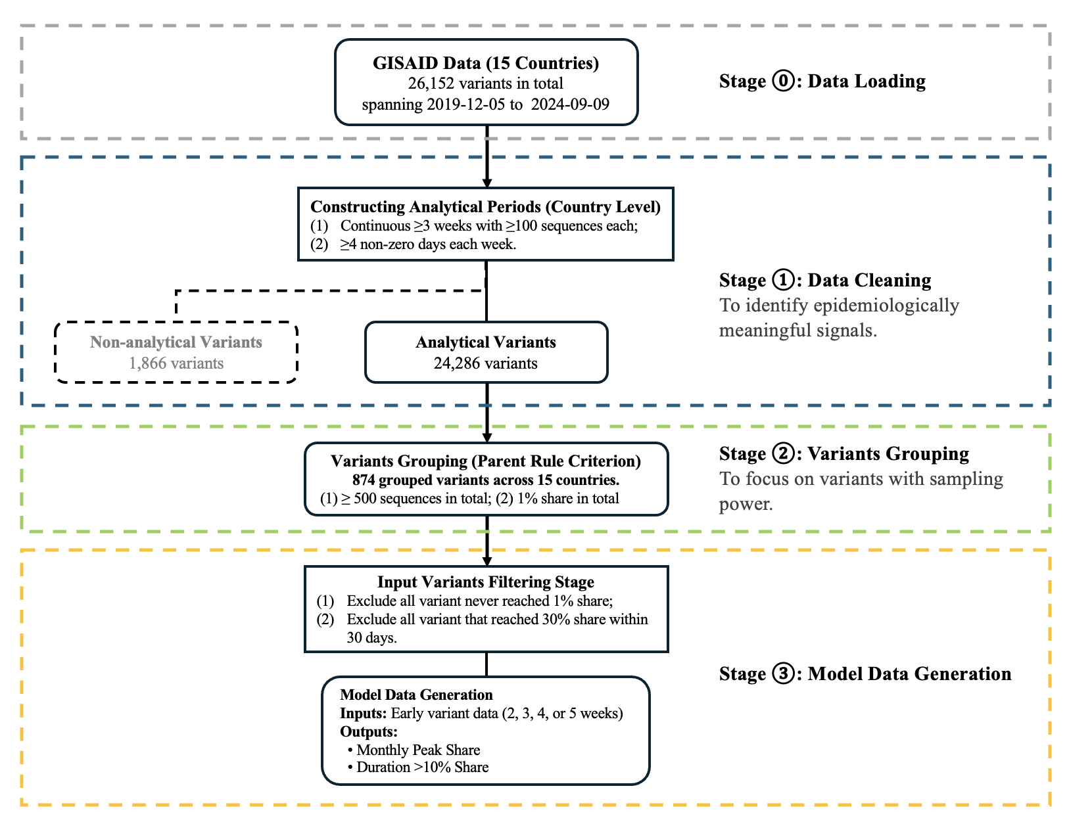

Data Processing (Overview)
4

Slide 7
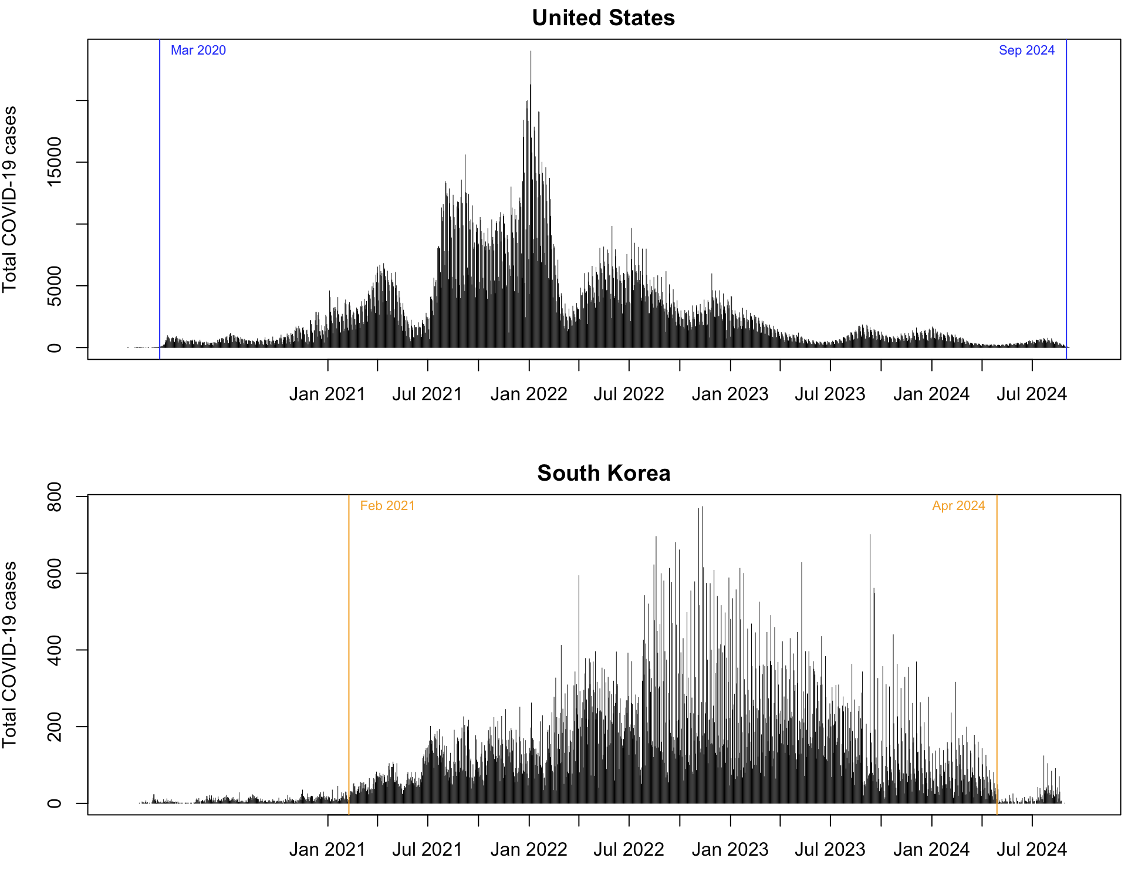
Stage 1: Data Filtering
What is “Analytical Period”?
Why we need it?
Definition: Continuous ≥3 weeks with ≥100 sequences each and ≥4 non-zero days each week [5].
Purpose: Ensures reliable, unbiased growth and peak estimates [6] by avoiding sparse sampling.
Cross-country difference: Varies with sequencing intensity—longer in high-coverage countries, shorter in low-coverage ones.
5

Slide 8
Stage 1: Data Filtering
6

Slide 9
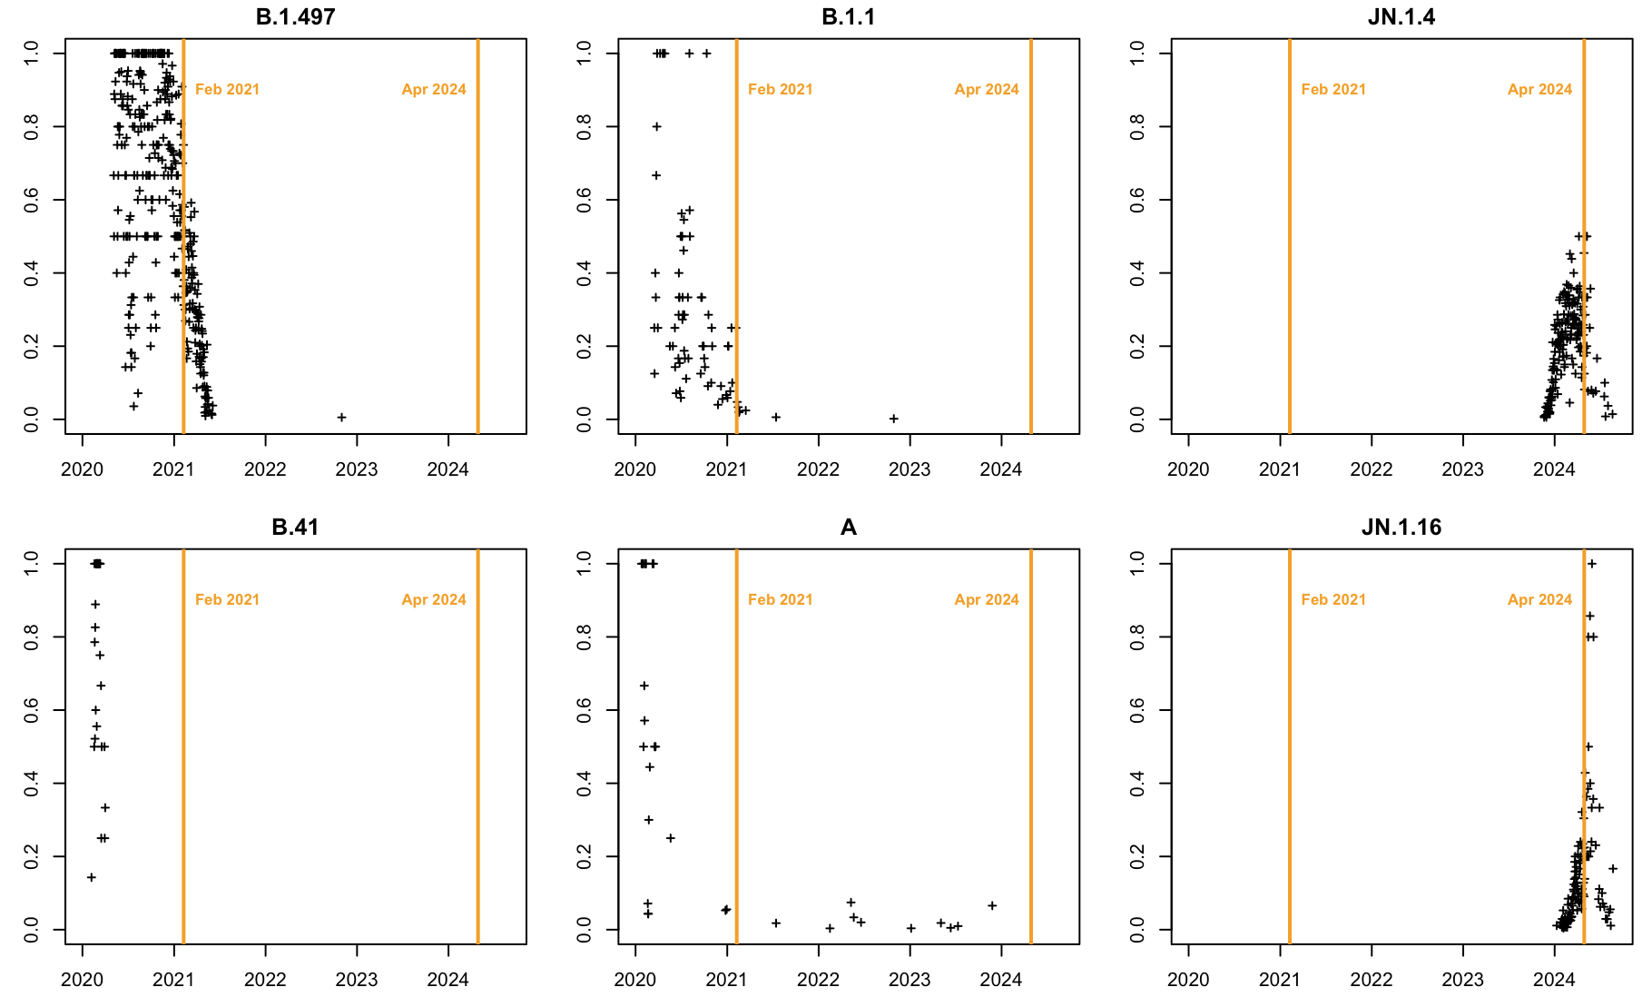
Stage 1: Data Filtering
Top Variants Excluded in South Korea
Criteria:
Variants initiating prior to or extending beyond the defined analytical period were excluded from subsequent analysis.
Here, lineages “B.1.497” “B.1.1” “B.41” and “A” are excluded because they began before the defined analytical period, while “JN.1.4” and “JN.1.16” are excluded because their trajectories extended beyond it.
Domestic Share
Domestic Share
7

Slide 10
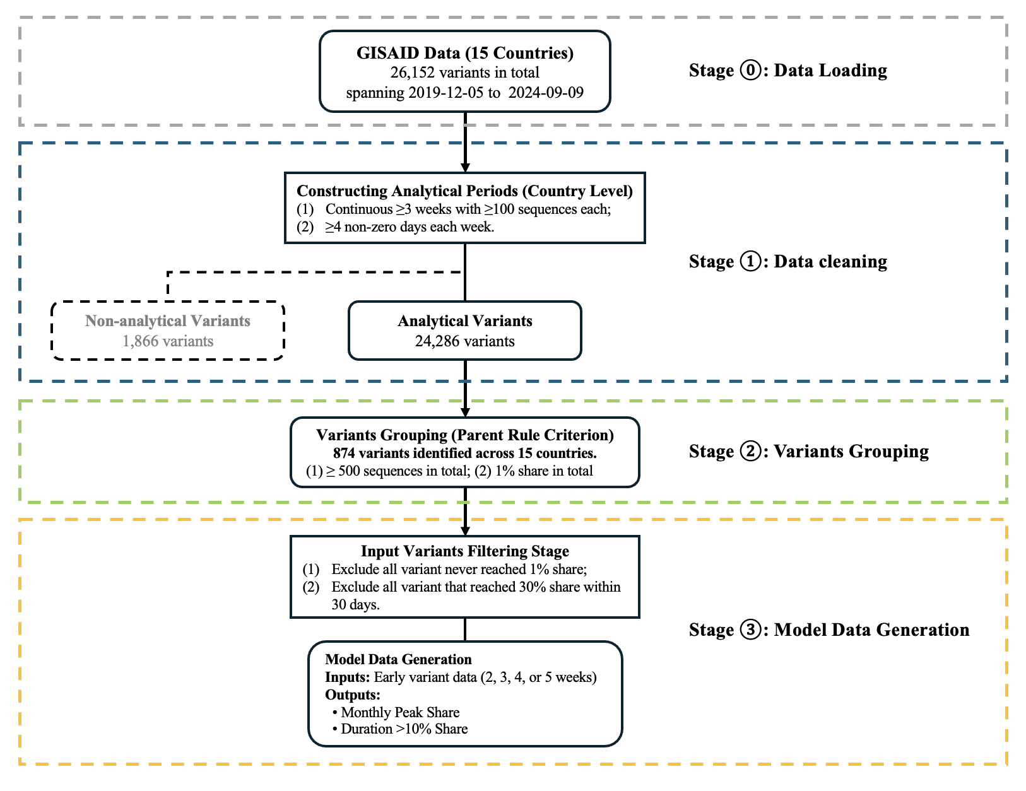
Data Processing (Overview)
8

Slide 11
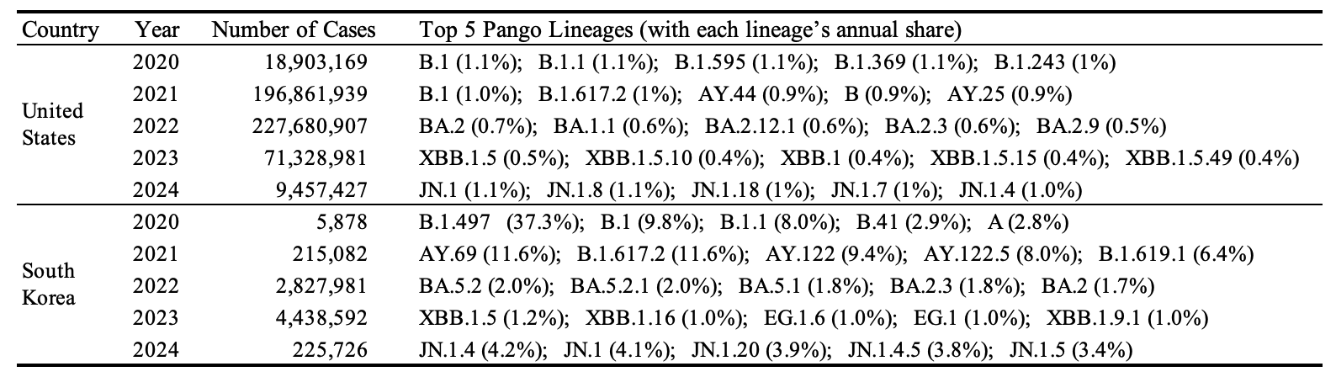
Stage 2: Variants Grouping
Why we need Variants Grouping???
Over 95% of GISAID lineages appear at less than 1% frequency, making raw data too sparse for meaningful analysis. Grouping consolidates rare variants, strengthens statistical signal, and enables more stable and comparable modeling across countries.
9

Slide 12
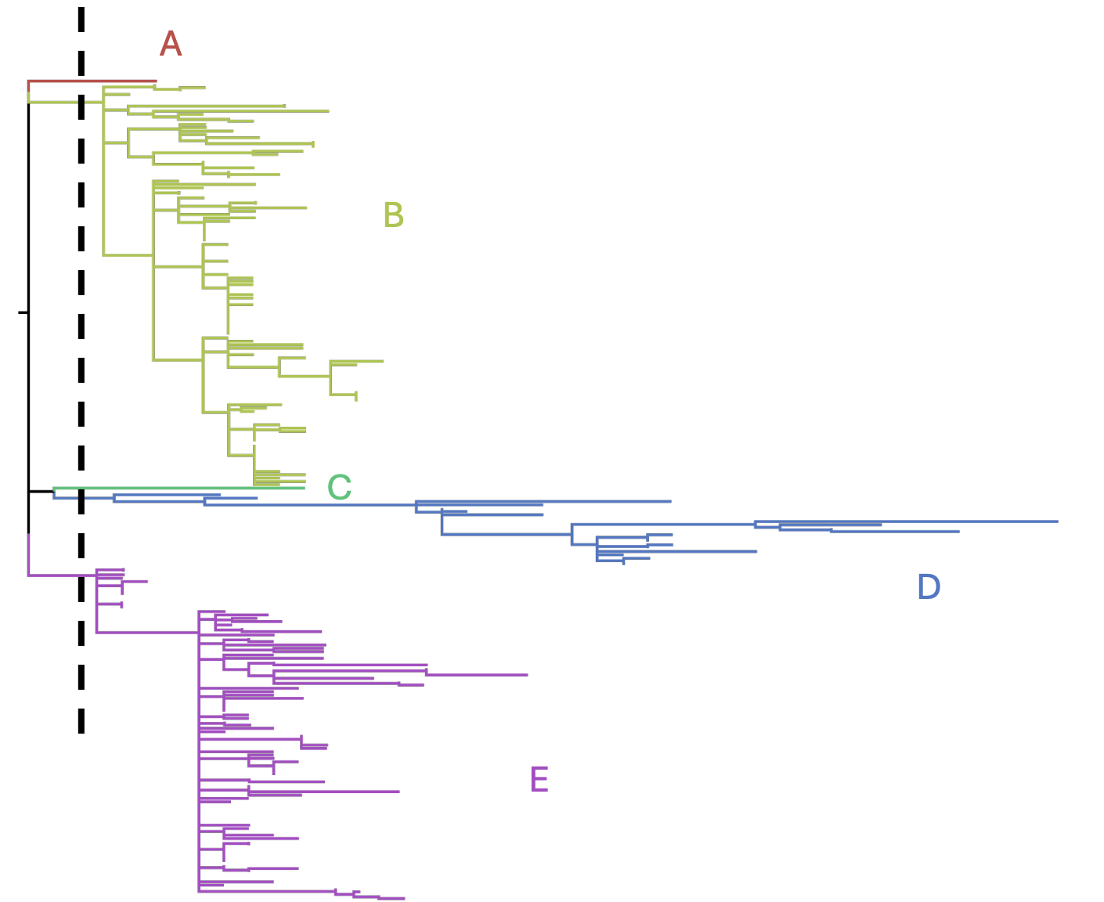
Stage 2: Variants Grouping
How we perform the grouping?
Consolidated fine-grained Pango lineages into broader, epidemiologically meaningful groups.
Applied grouping separately for each country to capture geographic heterogeneity.
Retained only groups with ≥500 infections by August 2024 to ensure analytical relevance.
Definition of PANGO lineages
Each lineage is given a unique alphanumeric code that contains partial, but not complete, information about the phylogenetic history of that lineage.
10

Slide 13
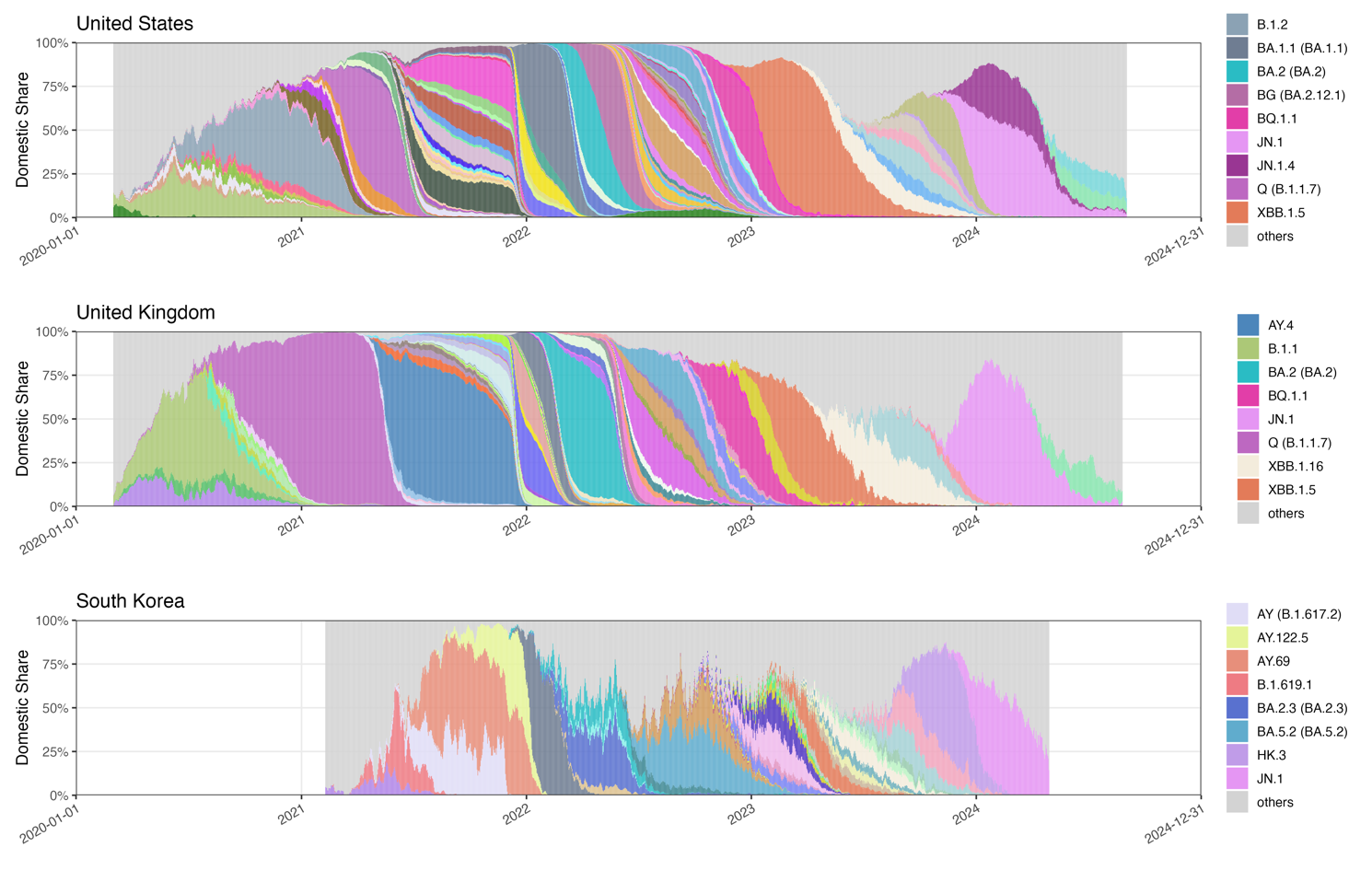
Stage 2: Variants Grouping
Time-series distribution of SARS-CoV-2 Grouped PANGO lineages in the UK, US, and South Korea. Legends include only lineages with monthly peak > 30% and duration > 100 days above 10% share.
11

Slide 14
Data Processing (Overview)
12

Slide 15
Data Processing (Overview)
GISAID data
(15 countries from 2019-12-05 to 2024-09-09)
N= 26,152
Excluded (N=1,866)
Continued ≥3 weeks with 100 sequences
≥4 non-zero days each week
Analytical variants
N= 24,286
1% share by epidemic waves
Grouped variants
N=874
Excluded (N=XX)
Variants never reached 1%
Variants reached 30% share within 30 days
Eligible variants for feature extraction
N=XX
12

Slide 17
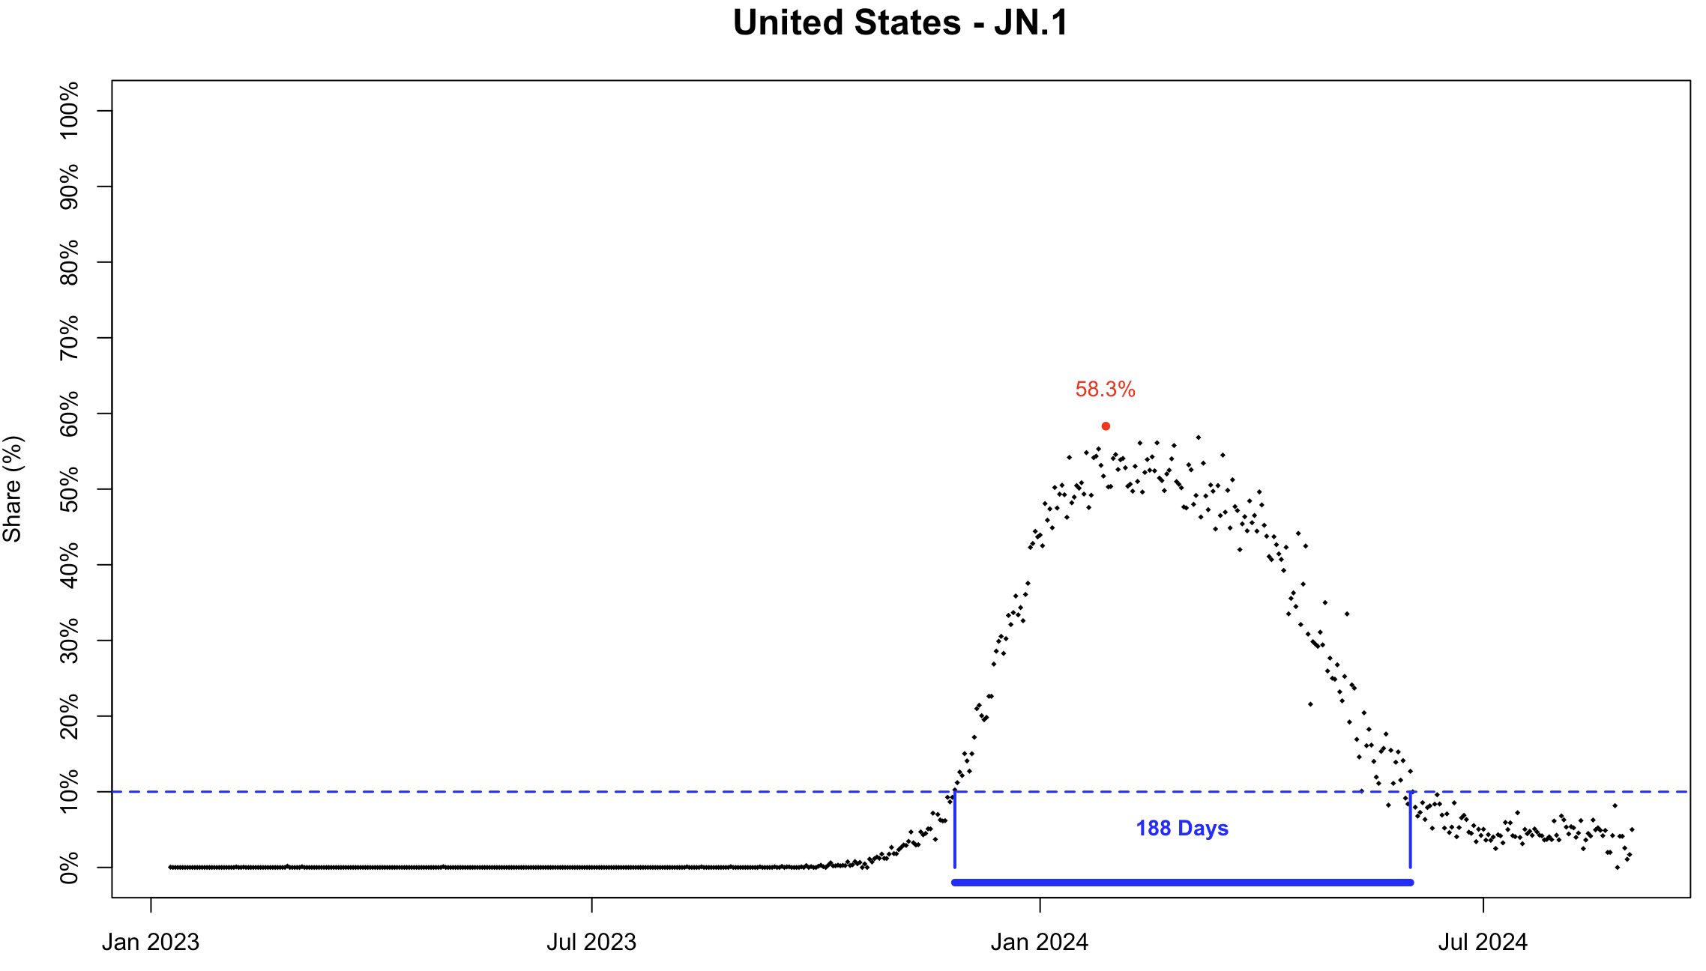
Stage 3: Model Data Generation
Outcome Definition – Dominance
We used two complementary measures: monthly peak share (variant’s maximum strength in a month) and duration above 10% share (how long it stayed epidemiologically relevant).
Compared with AUC, these measures are more interpretable: peak share captures intensity, duration captures persistence, together providing clearer insights into dominance dynamics.
Peak
Duration
13

Slide 18
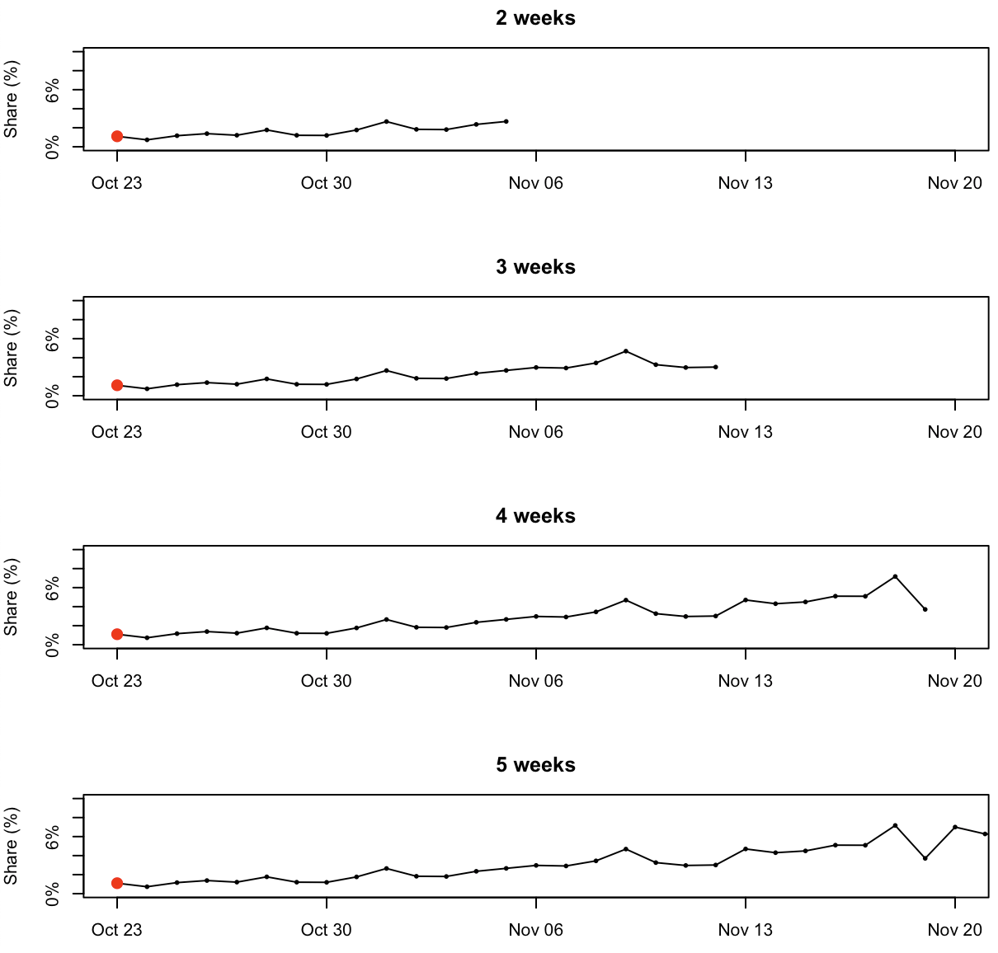
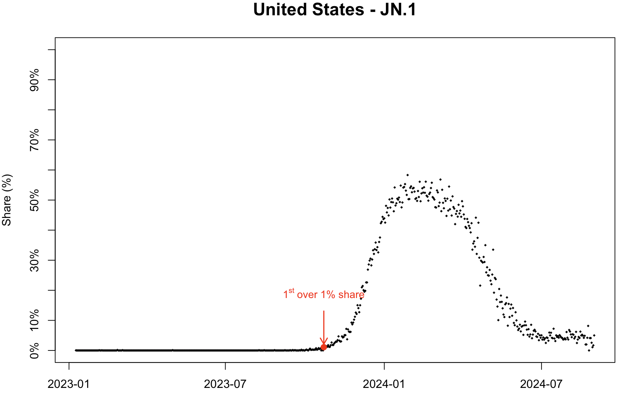
Stage 3: Model Data Generation
Initial Period Definition and Data Extraction
The initial period was defined as starting from the first date a variant reached 1% share, which avoids the influence of scattered early points or potential recording errors and ensures practical epidemiological relevance.
Following WHO guidance [7], we examined observation windows of 2, 3, 4, and 5 weeks to define and evaluate the initial period.
14

Slide 19
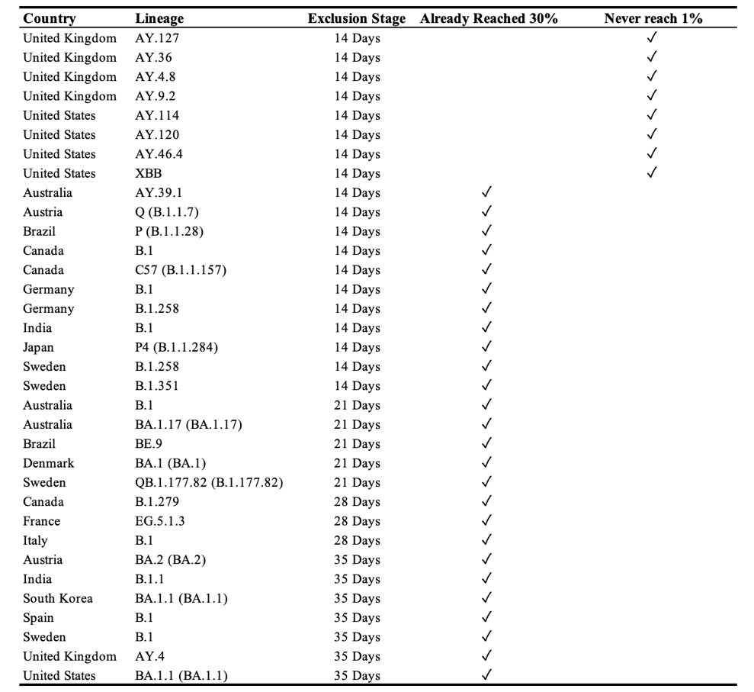
Stage 3: Variants Filtering
Two scenarios that Variants will be exclude:
Never reached 1% share.
Already reached 30% share within the Input periods.
15

Slide 20
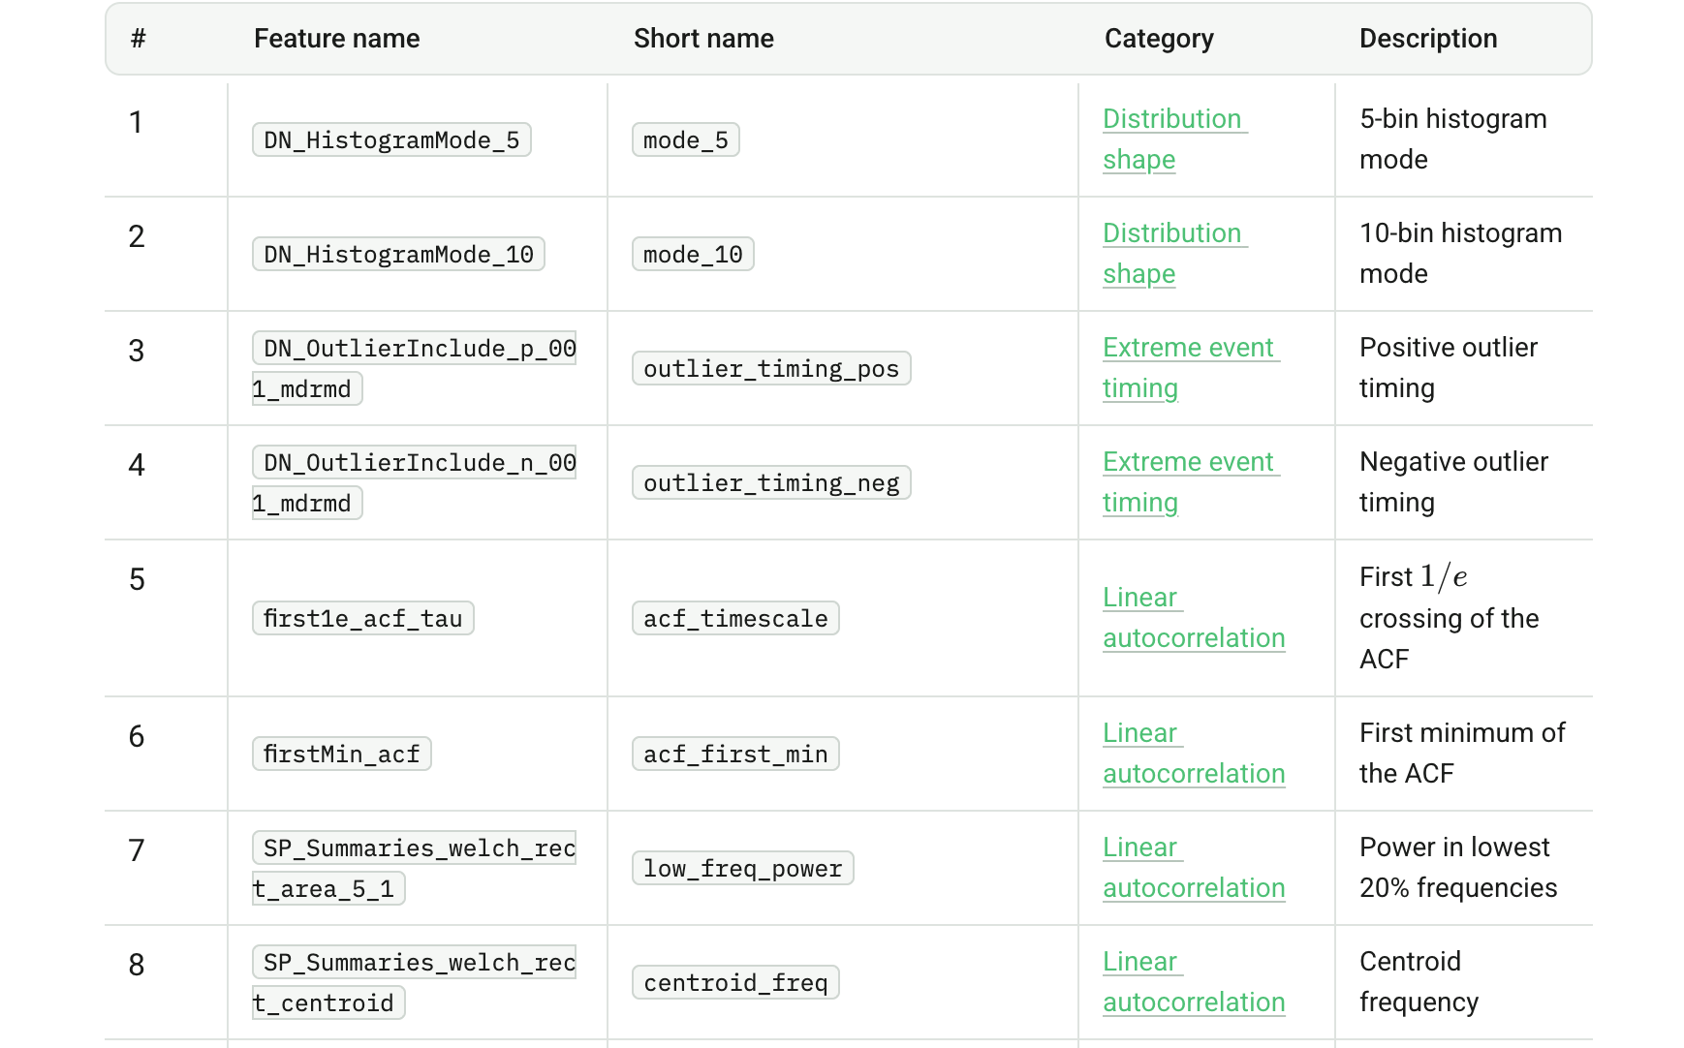
Stage 3: Model Data Generation
Input Features Generation
We constructed two types of predictors: four manually defined epidemiological indicators and a comprehensive set of automatically extracted time-series features using the R package {Rcatch22} .
( https://time-series-features.gitbook.io/catch22-features )
{Rcatch22} is particularly well suited for our setting, as its features are designed to capture diverse temporal dynamics from relatively short sequences, making it an effective complement to the manually defined indicators.
Manual features (epidemiologically motivated):
Log-linear slope (overall growth/decline trend)
Short-window slopes (7 days)
Longest increasing run (consecutive growth days)
Non-zero count (days with non-zero share)
Rcatch22 features (list of Top 8):
16

Slide 21
Data Processing (Overview)
17

Slide 22
Modeling Procedures

Slide 23
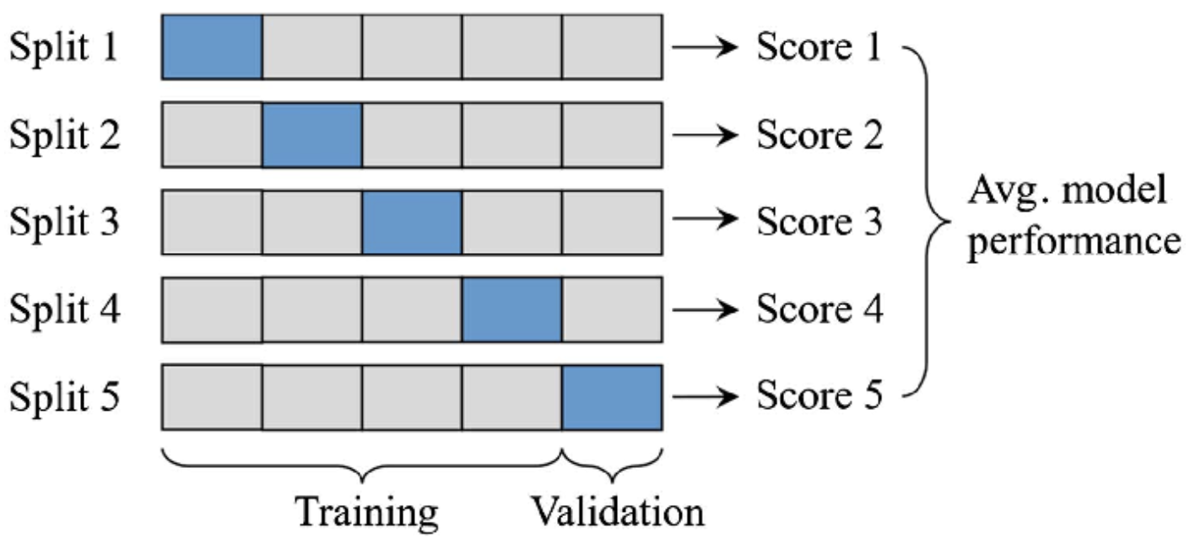
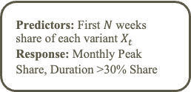

Modeling Procedures
Applied ML Regressor:
glm
bayesglm
gam
elasticnet
svm
nnet
CART
SuperLearner
Predictors: First $N$ weeks share of each variant $X_{t}$
Response: Monthly Peak Share, Duration >30% Share
Feature Extraction from $X_{t}:$
1) Manual features
2) {Rcatch22} features
Training Data (80%)
Choose CV folds
(5-fold-CV)
Get Model Scores
Fit model on train fold
Evaluate on Test fold
Test Data (20%)
Out-of-sample Performance
Peak: RMSE and R²
Duration: Accuracy and Marco-F1
Variant shares from the first N weeks were used to predict monthly peak share and duration above 10% share. Features included handcrafted and Rcatch22 descriptors. Several statistical and ML regressors were trained with 5-fold CV, with feature importance assessed via SHAP.
SHAP (SHapley Additive exPlanations) is a widely used method for interpreting machine learning models by quantifying each feature’s contribution to predictions.
We employed the SuperLearner R package, an ensemble learning framework that optimally combines multiple algorithms through cross-validated stacking. In this study, the ensemble combined CART, GLM, and ElasticNet learners—a balanced choice that optimizes both computational efficiency and predictive performance.
5-fold CV
Feature importance and SHAP analysis
18

Slide 24
Results & Analysis

Slide 25
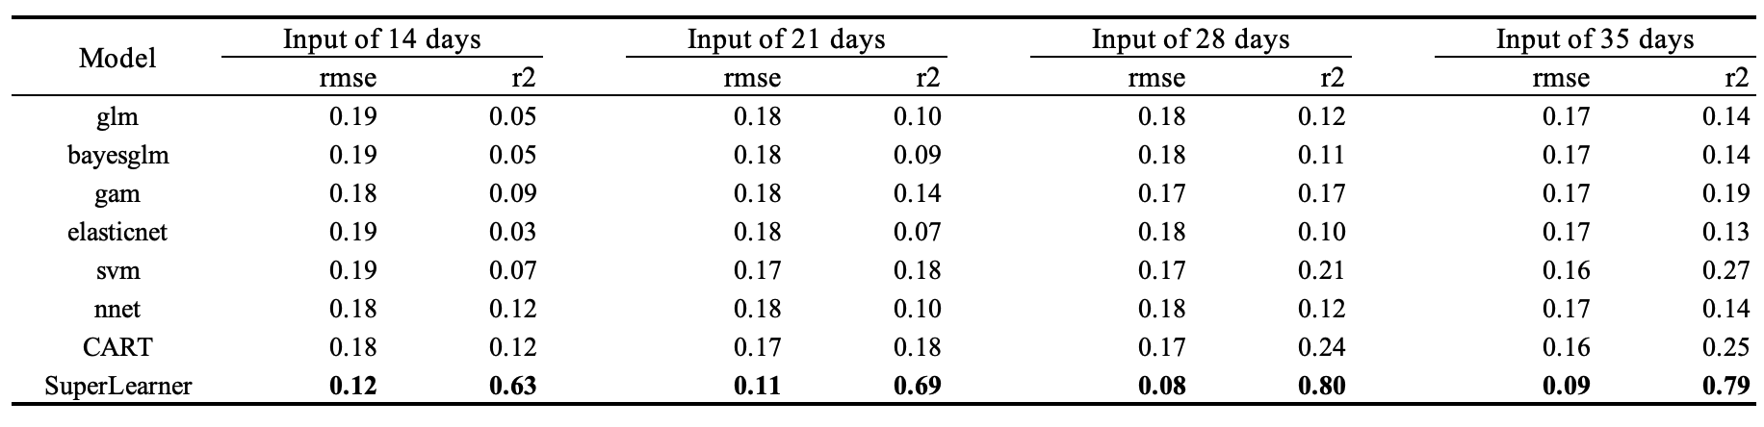
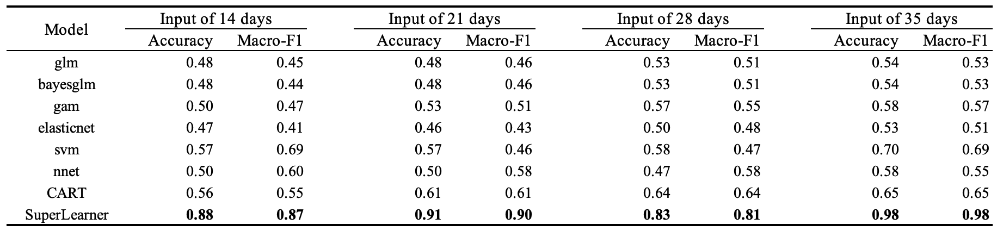
Model Evaluation
“Peak” Modeling Results Across different inputs and models
“Duration” Modeling Results Across different inputs and models
19

Slide 26
Model Evaluation
“Peak” Modeling Results Across Countries
For monthly peak share, Ensemble Learner (SL) yielded the lowest RMSE, performing best in countries with dense sequencing (Denmark, Germany, Japan, United States) and worse in Italy and Brazil with irregular sampling.
20

Slide 27
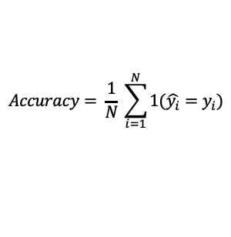
Model Evaluation
“Duration” Modeling Results Across Countries
For duration above 10% share Ensemble Learner (SL) achieved the highest accuracy. Model performance is strongest in Denmark, France, Italy, the UK, and the US, with accuracies above 0.9. Weaker results in South Korea, Brazil, and India due to greater data variability or instability.
Duration Categories
To address heterogeneity, this was discretized into four categories:
0 days
1–30 days
31–100 days
100+ days
The Accuracy is calculated:
$$Accuracy= \frac{1}{N} \sum_{i=1}^{N}{1(\hat{y_{i}}=y_{i})}$$
21

Slide 28
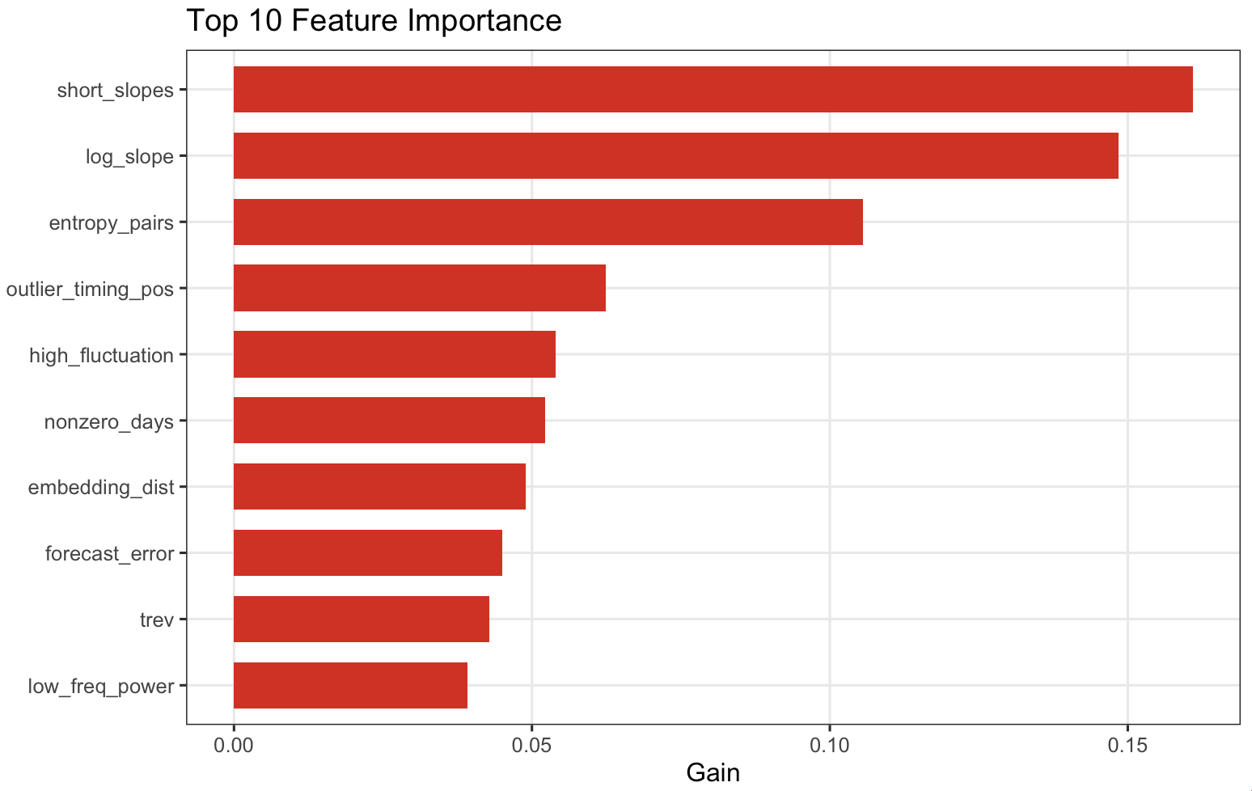
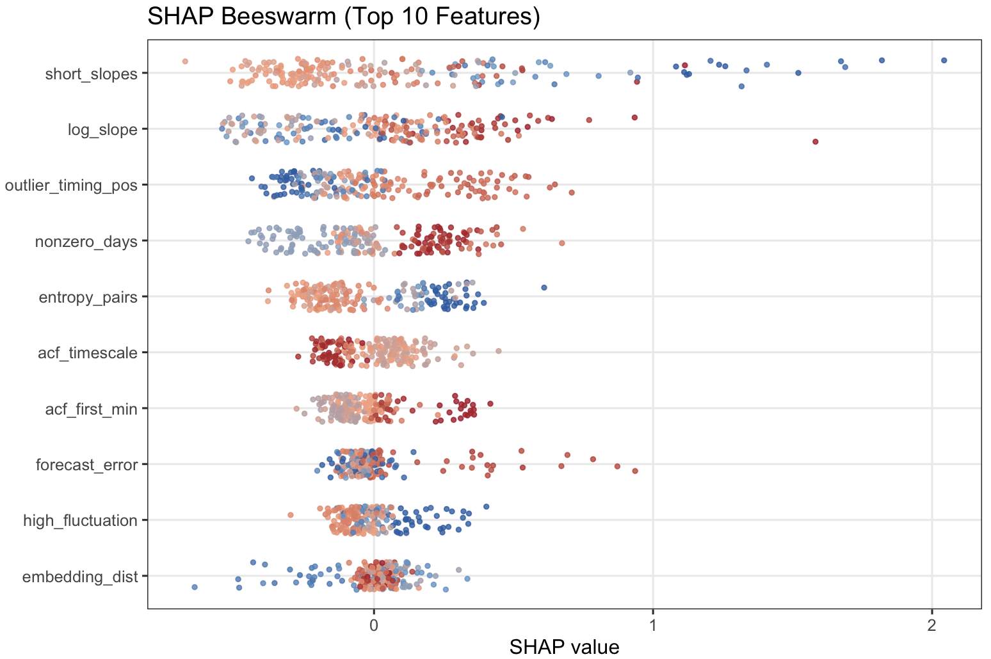
SHAP Analysis (SL)
“Peak” Modeling Results
High values (red) have negative impacts on the prediction
Low values (blue) have positive impacts on the prediction
The top five predictors—short_slopes, log_slope, entropy_pairs, outlier_timing_pos, and high_fluctuation—represent distinct aspects of variant temporal dynamics. short_slopes and log_slope capture early (7 days) and overall growth trends; entropy_pairs quantifies irregularity in prevalence trajectories; outlier_timing_pos detects sudden early surges; and high_fluctuation measures temporal variability.
SHAP analysis indicates that higher log_slope predicts greater peak prevalence, while lower short_slopes (slower early growth) favors future dominance. Greater entropy_pairs and high_fluctuation also associate with higher peaks, reflecting irregular and dynamic variant expansion.
22

Slide 29
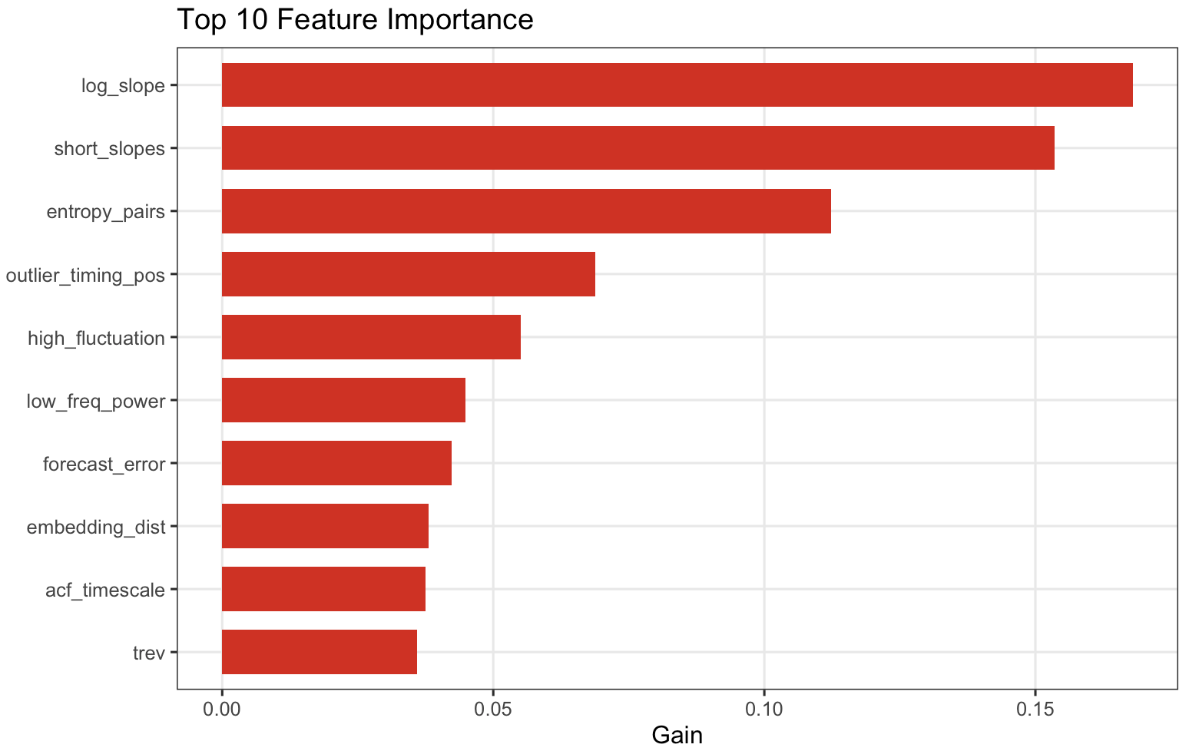
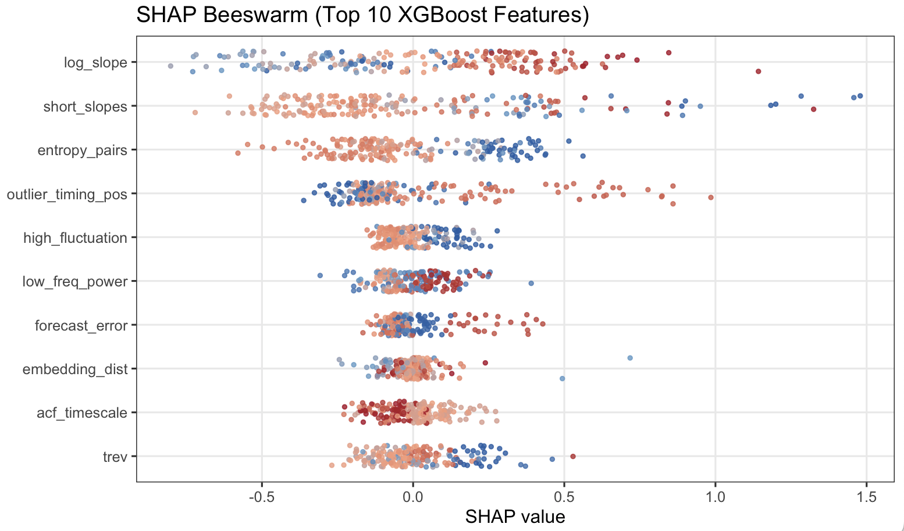
SHAP Analysis (SL)
“Duration” Modeling Results
Low values (blue) have negative impacts on the prediction
High values (red) have positive impacts on the prediction
The top five predictors—short_slopes, log_slope, entropy_pairs, outlier_timing_pos, and high_fluctuation—represent distinct aspects of variant temporal dynamics. short_slopes and log_slope capture early (7 days) and overall growth trends; entropy_pairs quantifies irregularity in prevalence trajectories; outlier_timing_pos detects sudden early surges; and high_fluctuation measures temporal variability.
SHAP analysis reveals that higher log_slope values are associated with extended variant persistence, while lower short_slopes (indicating slower initial growth) correspond to longer durations, suggesting that sustained rather than rapid expansion promotes persistence. In contrast, higher entropy_pairs and high_fluctuation exhibit negative associations, indicating that irregular and unstable temporal dynamics shorten variant longevity.
23

Slide 30
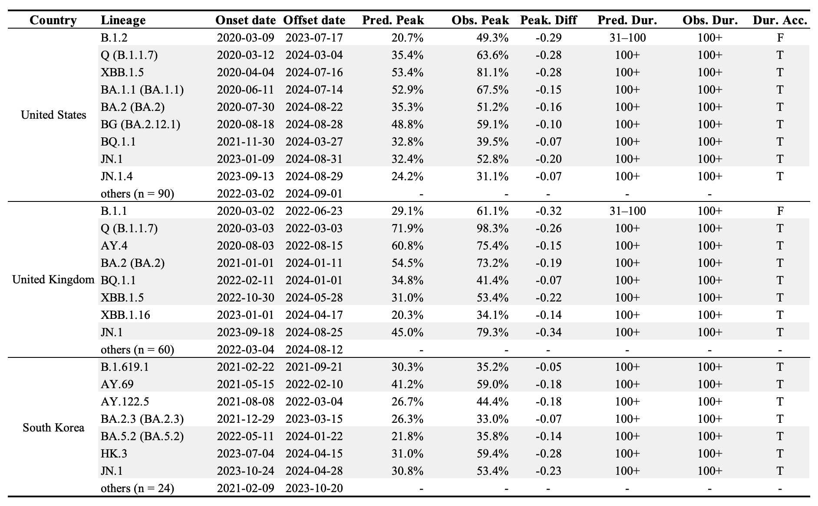
Model Application (SL)
Notation:
Using 4 weeks initial share input data, our model successfully predicts whether peak share is below 30% and whether duration is under 100 days, with correct predictions for both highlighted by a gray background.
24

Slide 31
Conclusion
We used global GSAID variants’ time series data for country-specific prediction, addressing data sparsity and heterogeneity to define the country-specific analytic period and variant-specific initial period.
We defined future dominance by the peak model, which reflects transient dominance, whereas the duration captures long-term persistence—together providing complementary insights into variant competitiveness.
We established an efficient and scalable data-processing and modeling pipeline for SARS-CoV-2 variants—highly applicable for sewage surveillance and seasonal respiratory infection forecasting—integrating various feature extraction and SHAP-based uncertainty analysis to identify key drivers.
Both peak and duration models reveal that sustained one-month growth leads to higher peaks and longer persistence, while 7 days rapid early growth, negatively impacts future dominance.
Ensemble learning models achieved substantially better out-of-sample performance than single learners (For peak prediction, the ensemble reduced RMSE from 0.20 to 0.08, a 60% improvement in predictive accuracy; For duration prediction, the ensemble achieved 96% accuracy, markedly outperforming CART (58%) and GAM (51%).), confirming their superiority for variant dominance forecasting.
25

Slide 32
Limitation & Discussion
Although the modeling window starts at the first 1% share to reduce noise, variants with very low peak shares still lose much of their early dynamics, limiting the capture of informative initial patterns.
The model was trained jointly across 15 countries. This pooling strategy improves sample size overall, but it also means the model may be biased toward countries with denser sequencing data, while underrepresenting countries with fewer samples.
Cross-country heterogeneity in forecasting performance largely reflects differences in sequencing intensity, coverage, data continuity, reporting lags and epidemiological context—factors that shape how early variant growth signals translate into dominance across settings.
Despite these challenges, sequence-only time-series features—particularly early growth slopes, temporal entropy, and fluctuation patterns (requiring at least ≥100 sequences per week for ≥3 weeks; ≥500 total and ≥1% share detection thresholds) —contain sufficient information to anticipate future variant dominance and persistence.
26

Slide 33
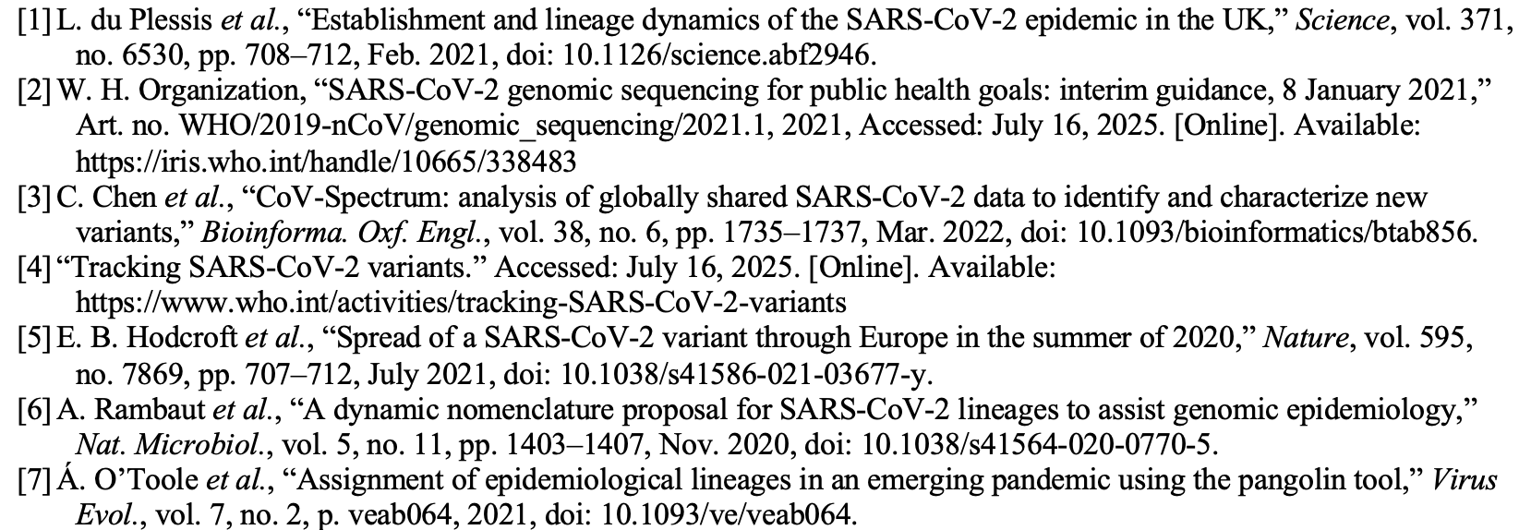
References
27

Slide 34
Thanks!
Any questions?
zfranky6@uconn.edu

